Slide 1

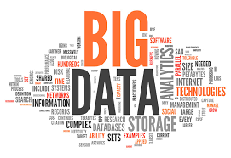
Azure Big Data
Workshops
Future Processing 2019.01.26
Bartłomiej Michalski
Kamil Dworak
Tomasz Krawczyk Sebastian Zęderowski

Slide 2
Agenda
Big Data – quick overview
Lambda Architecture
Create scalable application to proces data in On-line and Off-line mode based on Azure cloud.

Slide 3
Who are we?
FP Data Solutions?
Our experience

Slide 4
Goals
Share knowledge about big data
Exchange experience
Have fun

Slide 5
Big Data - introduction

Slide 6
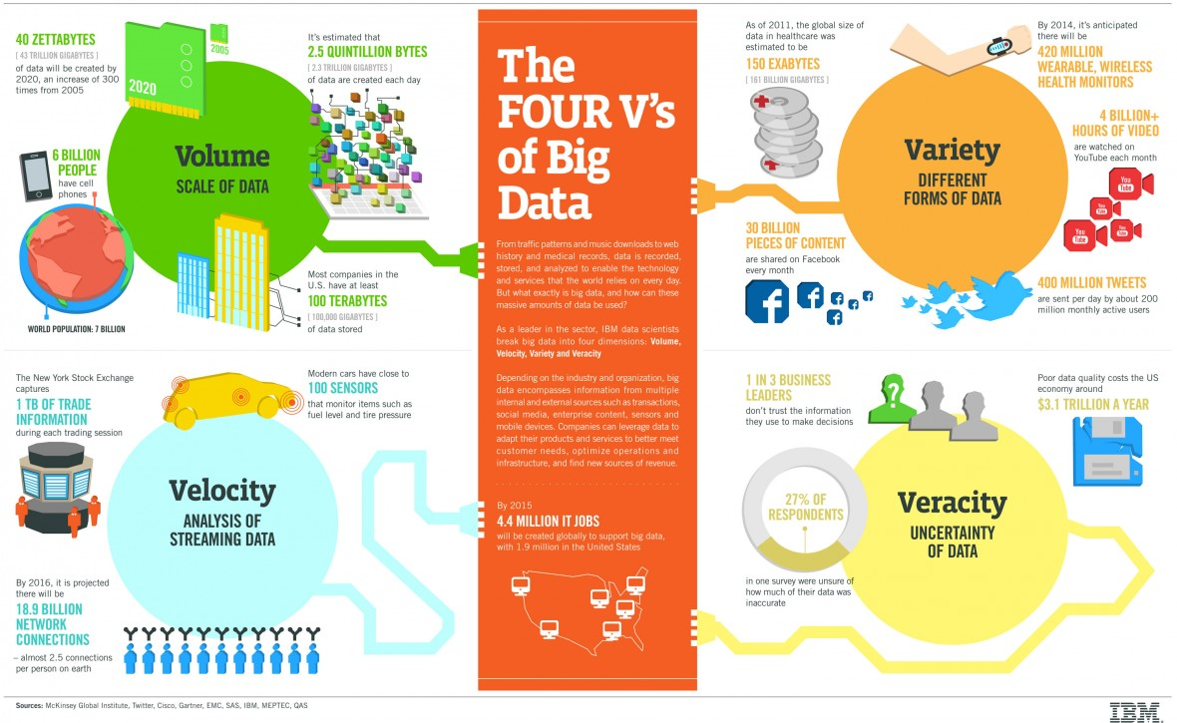
VVVVs

Slide 7
163 Zetta bytes by 2025
163 Zetta bytes =
163 000 000 000 000 000 000 000 bytes
163 *2⁷⁰ bytes 163 * 1024⁷ bytes
If 1 bytes = One grain of rice
then Zetta byte = Fills the Pacific Ocean
Watching the Netflix catalog
489 million times

Slide 8
3Vs of Big Data
Data Volume
Byte One grain of rice
Kilobyte Cup of rice
Megabyte 8 bags of rice
Gigabyte 3 semi trucks
Terabyte 2 container ships
Petabyte Blankets Manhattan
Exabyte Blankets west coast states
Zettabyte Fills the Pacific Ocean
Yottabyte As earth-sized rice ball
Data Variety
Structured
Unstructured
Semi-structured
All the above
Data Velocity
Near to Real Time
Batch
Notes:
Według szacunkow wygenrujemy 40 zetta
Czy to duzo czy malo –posluzymy sie porownaniem ktore przedstawil Microsoft
Ale big data to nie tylko rozmiar
Podstawowa definicja Big data to 3V
Data Valume, Data Variety –rozne format danych
Oraz szybkosc przyrastanie danych –ja to rowniez rozumiem jako sposob przetwarzania
Dzis skupimy sie na rozwiazaniu ktore umozliwia przetwarzenie danych w trybie batchowym

Slide 9
Schema-on-Read vs Schema-on-Write
Schema-on-Read
(Hadoop or ADLS):
Schema-on-Write (RDBMS):
Copy data in its native format
Create schema + parser
Query Data in its native format (does ETL on the fly)
Create static DB schema
Transform data into RDBMS
Query data in RDBMS format
Notes:
Jedna z zasadniczych roznic jesli chodzi o przetwarzanie Big Data jest to, ze dane mamy w surowym formacie a schemata nakladamy w momencie przetwarzania
W RBMS/DW najpierw tworzymy schematy potem skomplikowane procesy ETL w przypadku DW tak aby dane dostosowac do celowych schematow I potem za pomoca SQL
Mozemy analizowac nasze dane

Slide 10
Lambda Architecture
COLD PATH
Input Data
All Data
Precomputed Views
BATCH LAYER
Batch View
Queries
Real Time View
Recent Data
Incremental Views
SPEED LAYER
HOT PATH
Notes:
Jesli chodzi o torie i procesowanie danych to teoria mowi ze jednna z mozliwosci jest architektura Lambda
Co zatem mowi architektura Lambda o przetwarzaniu danych
W architekturze Lambda dane dzielimy na tzw HOT I COLD data.
Każde z tych dwóch grup danych procesowana jest osobno
Dane COLD przetwrzane sa w trybie batchowym – oznacza to ze najpierw zbieramy jakis dataset danych np. z jednego dnia a nastepnie uruchamiane jest przetwarzeanie takiego datasetu
Dane HOT przetwarzane sa w trybie Near to real time lub trybie tzw microbatchy –takie podejście używane jest w przypadku kiedy chcemy robić online’owe analizy danych
Przeprocesowane dane udostepiane sa za posrednictwem aplikacji uztkownikowi

Slide 11
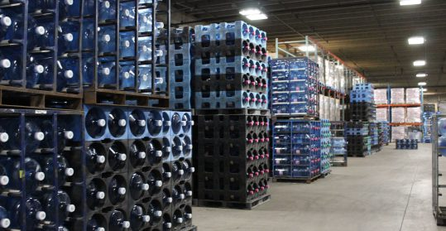

Data Lake Approach
What is Data Lake ?
“If you think of a datamart (a subset of a data warehouse) as a store of bottled water – cleansed and packaged and structured for easy consumption – the data lake is a large body of water in a more natural state„
Pentaho CTO James Dixon
Source: https://premiumwaters.com
Source :https://snowbrains.com
I(ngest) S(tore) A(nalyse) S(urface) A(ct)
Make Me More Money
Notes:
Jesli chodzi o przetwarzanie duzych zbiorow danych to ostatnio staje sie popularne podejscie przewtarzania oparte o Data Lake.
Koncepcja ta bardzo mocno wpisuje się w architektura Lambda w process przetwarzania COLD Data
Czym jest Data Lake ? CTO Pentaho James Dixon zdefiniowal data lake w nastepujacy sposob : jesli DW to magazyn z woda to DL do woda w naturalnej postaci
Jest jeszcze jedna definicja DL – to ISASA –czyli skrot od Ingest Store Analyse Surface Act
Z binesowego punktu widzenia najwazniejszy jest ACT –czy Make Me More Money
Najogolniej mowiac DL to konetener na roznego rodzaju dane – wrzucamy tam dowolne dane I przetwarzamy jest w zaleznosci od potrzeb

Slide 12
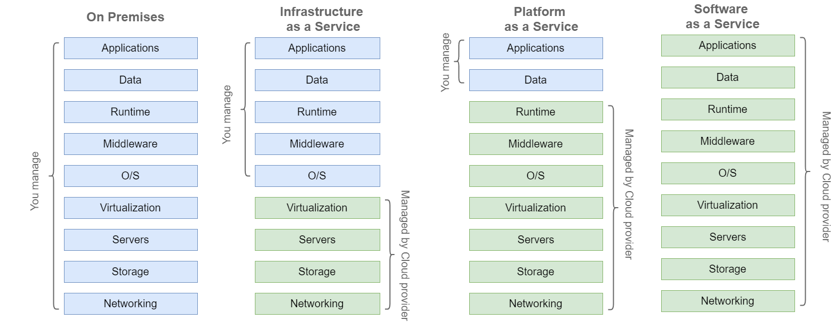
Cloud Models

Slide 13







Azure – Lambda architecture (Hot Path)
Input
Data
Input
Stream Analytics
Processing
Event Hub
Gateway
Web Jobs
IoT Hub
Azure Databricks
Batch Processing
PUSH
Azure Blob Storage
Azure Data Lake Storage
Store

Slide 14








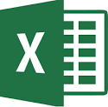
Azure – Lambda architecture (Cold Path)
Storage
Input
Data
Ingest
Azure Blob Storage
Azure Data Lake Storage
Azure
SQL Server
Web Application
Azure Data Factory
Power BI
PULL
Azure
Cosmos DB
Azure HDInsight
Azure Databricks
Azure Data
Lake Analytics
Analyse
Excel
Azure Data
Warehouse
Notes:
Moze zaczniemy od tego, aby dopasowac –tak aby mozna bylo zbudowac rozwiazanie w oparciu o architecture Azure.
Nastepnie krotko przenanalizujmy kazda z tych usug

Slide 15
Azure Services

Slide 16
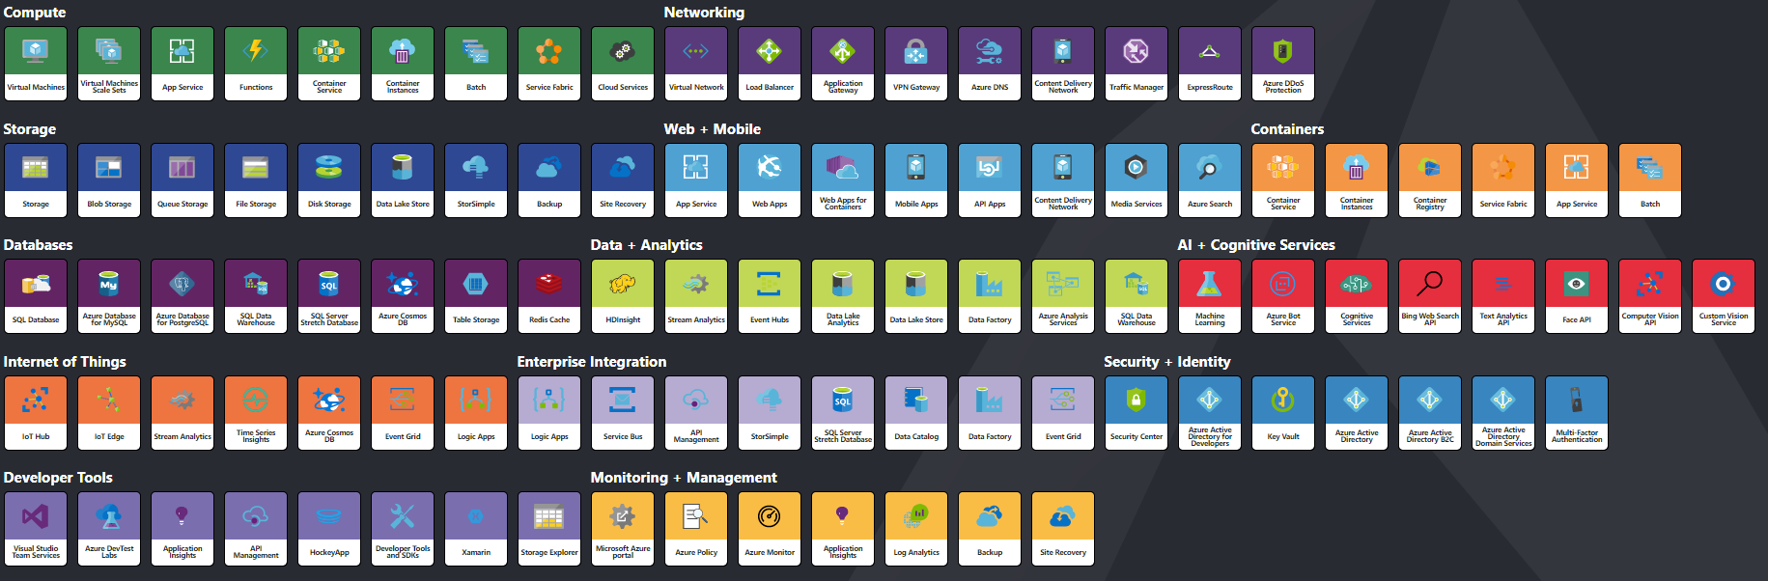
Azure – Services

Slide 17
Your today task
Nasz klient posiada wiele urządzeń do sprzedaży słodyczy/napojów itd. Urządzenia te posiadają dostęp do sieci. Nasz klient chce mieć możliwość monitorowania stanu pracy czy urządzeń w zakresie podstawowych parametrów pracy oraz stanu danego towaru na danym urządzeniu tak aby, mógł szybko zareagować w przypadku wykryciu anomalii lub braku towaru.
Dodatkowo nasz klient chce mieć możliwość generowania dziennych/miesięcznych/rocznych statystyk dotyczących funkcjonowania jego biznesu np. ilość sprzedanego towaru danego dnia, zysk z danego urządzenia.

Slide 18
Your today task
Wymagania niefunkcjonalne:
Rozwiązanie ma być skalowalne (aktualnie nasz klient ma 1000 urządzeń), ale rozwiązania ma umożliwiać obsługę 100 000 urządzeń.

Slide 19
10 minutes - design a solution for this problem

Slide 20
Generating Data – It is all about data

Slide 21
Azure – Big Data Storage
Azure Blob Storage
Azure Data Lake Storage (Gen1)
General purpose object store
Object store with flat namespace
Hot/cold/archive tiers
Data replication and redundancy options
Unlimited storage, petabyte files
WebHDFS-compatible REST interface
Hadoop and big data optimizations
Supports files and folders objects
Azure Data Lake Storage (Gen2)
Multi-modal combining features from both of the above
Not a separate service: Azure Storage with new features

Slide 22
Azure Data Lake Store (Gen1 & Gen2)
Built for Hadoop
WebHDFS-compatible REST interface
Unlimited storage, petabyte files
Highly-available and secure
Supports files and folders objects
Files are split apart into Extents (250 MB)
For availability and reliability, extents are replicated (3 copies).
Enables: Parallel read and Parallel write

Slide 23

Ingest of streaming data
Event Hub
IoT Hub

Slide 24
Azure Event Hub vs IoT Hub
Azure Event Hub is a highly scalable data streaming platform and event ingestion service, capable of receiving and processing millions of events per second
Azure IoT Hub is a fully managed service that enables reliable and secure bidirectional communications between millions of IoT devices and a solution back end
Area | IoT Hub | Event Hub
Device protocol support | Supports MQTT, MQTT over WebSockets, AMQP, AMQP over WebSockets, and HTTPS. | Supports AMQP, AMQP over WebSockets, and HTTPS.
Device state information | Device twins can store and query device state information. | No device state information can be stored

Slide 25
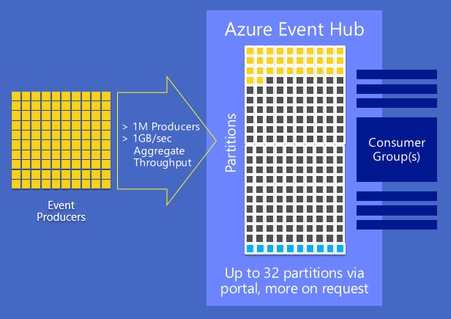
Azure Event Hub vs IoT Hub
General purpose object store
Object store with flat namespace
Hot/cold/archive tiers
Data replication and redundancy options

Slide 26

Azure Event Hub vs IoT Hub
OR
Azure HDInsight
Azure Databricks

Slide 27
Azure Databricks
Azure Databricks is an Apache Spark-based analytics platform optimized for the Microsoft Azure cloud services platform
Integration with Azure services:
SQL Data Warehouse
Cosmos DB
Data Lake Store
Blob Storage
Event Hub
Integration with Azure Active Directory
Notebooks : R, Python, Scala, or SQL

Slide 28
Apache Spark - Marketing
Apache Spark™ is a unified analytics engine for large-scale data processing.
Speed
Easy of use
Generality
Runs Everywhere

Slide 29
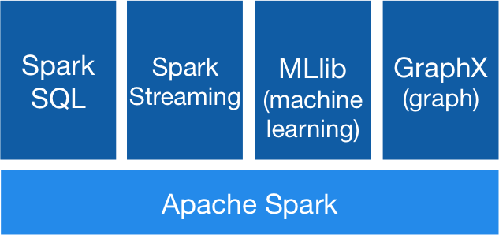
Apache Spark - Stack
https://spark.apache.org/images/spark-stack.png

Slide 30
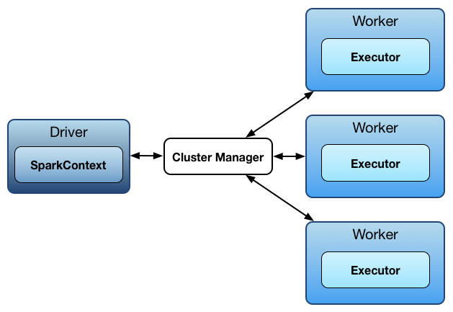
Apache Spark - Architecture
https://jaceklaskowski.gitbooks.io/mastering-apache-spark/spark-architecture.html

Slide 31

Apache Spark – Hosting
http://www.agildata.com/wp-content/uploads/2016/03/Blog-InlineIMAGES-ClusterManagement.png

Slide 32
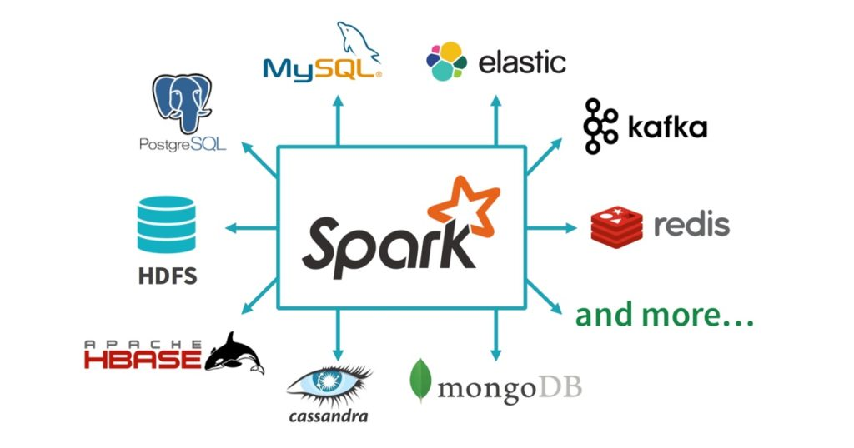
Apache Spark - Architecture
https://jaceklaskowski.gitbooks.io/mastering-apache-spark/spark-architecture.html

Slide 33
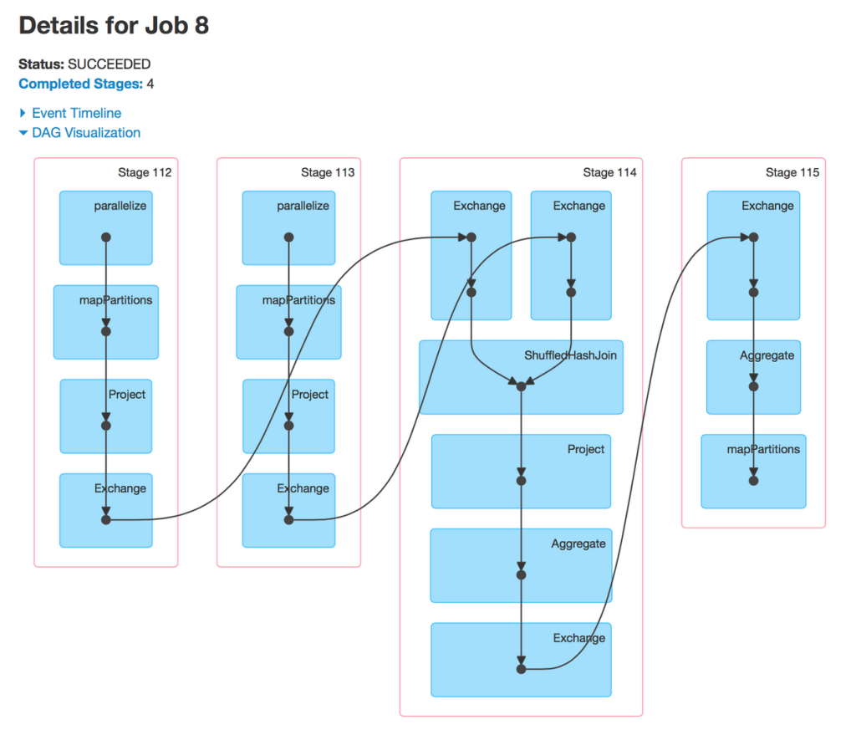
Apache Spark – Core API
Scala, Java, Python, R, SQL

Slide 34
Apache Spark - Basics
Transformations
Load, Map, Reduce, Filter, Fold
Actions
Collect,Save
Operation, optimisation of dag
Lineage recovery

Slide 35
Apache Spark – Databricks Experience
WebUI, Notebook,
Scalability
Multiple User
Data Science – Exploration
Demo

Slide 36
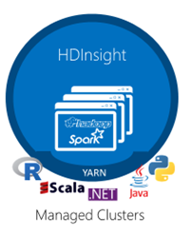
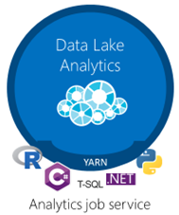
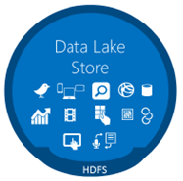
Big Data on Azure
Analytics
Azure Databricks
Storage
Notes:
Big Data jak sama nazwa wskazuje to chyba duzo danych a wiec prawdopodobnie bedziemy potrzebowac duzo mocy obliczeniowej, a ta znajdzemy w chmurze.
Zobaczymy zatem co mamy w chmurze Azure do przetwarzania danych
Jesli mowimy o przetarzaniu danych w chmurze Azure to zawsze bedziemy musieli powiedziec o Storage oraz uslugach analycznych I zwykle te dwie usulugi sa ze soba rozdzielone
Jesli chodzi o Storage to dla Big Data na Azure Mamy ADLS (Blob) ADLS Gen 2
Przetwarzanie
HDInsight Spark,Hive Machine Learing
Azure Data Lake Analytics
Azure Databricks –ktore weszlo na poczatku 2018 I bardzo moca sie rozpycha (jest duzy boom na ta usluge np. ADF Data Flow)

Slide 37
Azure Data Lake Analytics
A distributed analytics service built on Apache YARN that dynamically scales to your needs
Pay PER QUERY & Scale PER QUERY
FEDERATED QUERY across Azure data sources
Includes U-SQL, a language that unifies the benefits of SQL with the expressive power of C#
No limits to SCALE
Optimized to work with ADL STORE

Slide 38
U-SQL Data Types
Numeric – sbyte – int – long – float – double – decimal – short – byte – uint – ulong – ushort
Text – char – String (128 kB) › Complex – MAP<k,v> – ARRAY<v> › Miscellaneous – bool – Guid – DateTime – byte[] › RowSets
SQL.ARRAY<T> == IList<T>
SQL.MAP<T,U> == IDictionary<T,U>
@m = SELECT new SqlArray<string> (tweet.Split( new char[]{' '}).Where(x => x.StartsWith("@"))) AS mentions FROM @t;
@m = SELECT m.Substring(1) AS m,"mention" AS category FROM @m
CROSS APPLY EXPLODE(mentions) AS t(m);
Notes:
Typy danych danych – to co znamy z C#
+
SQLARRAY I SQLMAP to znamy z Hive
Poza tym mamy RowSets – odpowiednik tabeli w SQL (lub dataframe w pyton lub R)

Slide 39
U-SQL Top 5’s Surprises for SQL Developers
U-SQL is case sensitive
AS is not as
C# keywords and SQL keywords overlap
= != ==
C# expression language
null IS NOT NULL
C# nulls are two-valued (HasValue)
No UPDATE, DELETE, nor MERGE
Notes:
Jak ktos jest programista SQL to moze go spotkac kilka niespodzianek

Slide 40
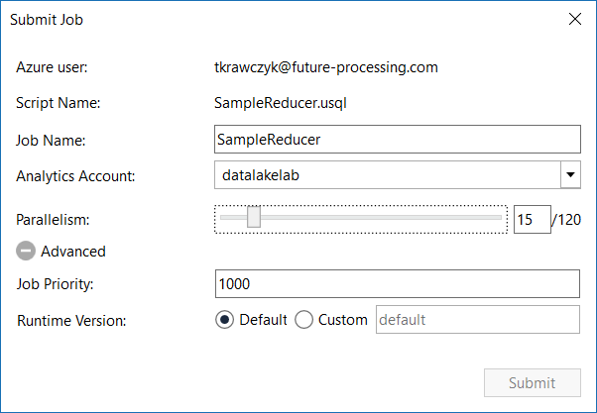
Data Lake Analytics Runtime
1 ADLAU ~= A VM with 2 cores and 6 GB of memory
Limited Network Access *
Parallelism N = N ADLAUs

Slide 41
ETL vs ELT
ETL (Extract Transform Load)
Schema On-Write
Data Warehouse
ELT (Extract Load Transform)
Schema On-Read
Data Lake
Notes:
Jesli chcemy analizowac nasze dane –musimy je napierw jakos pobrac I zoogranizowac
For the last couple of decades ETL (extract, transform, load) has been the traditional approach for data warehousing and analytics. The ELT (extract, load, transform) approach changes the old paradigm. But, what’s actually happening when the “T” and “L” are switched?

Slide 42
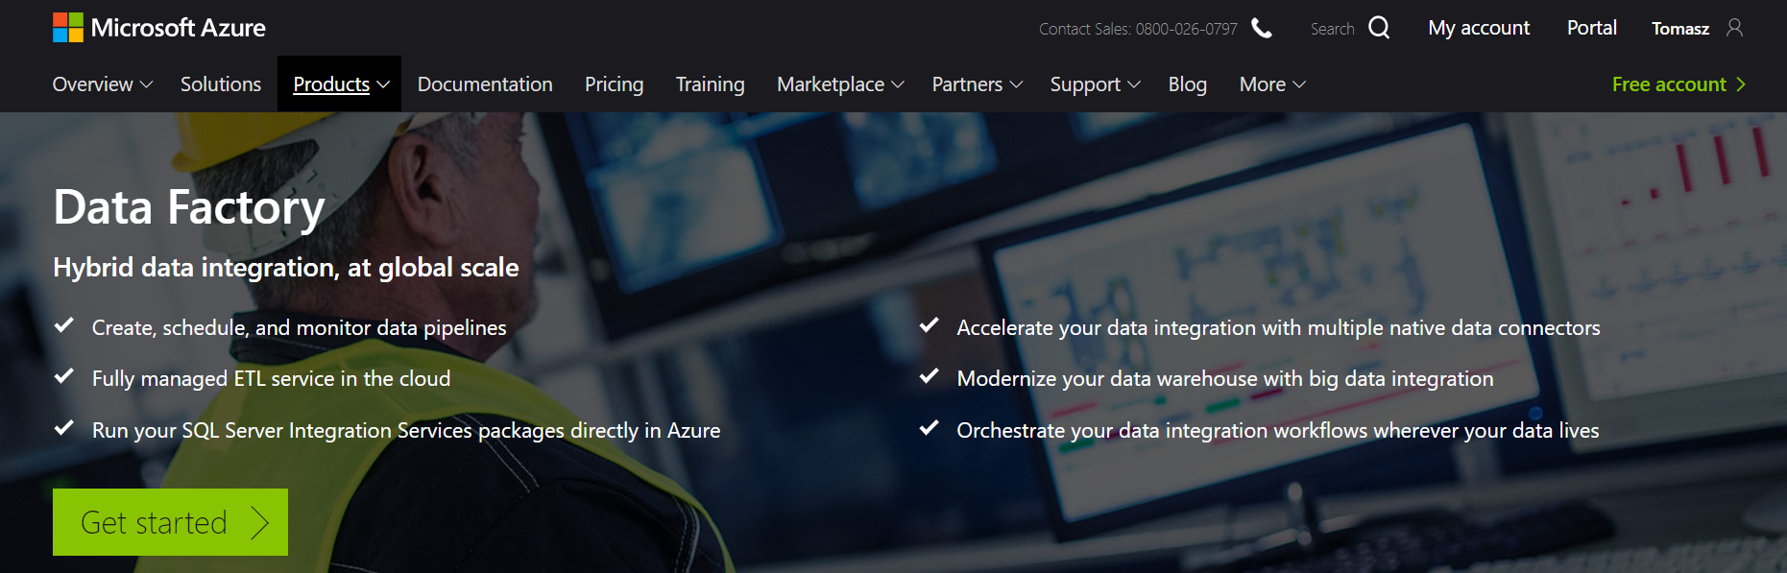
Azure Data Factory (V2)
https://azure.microsoft.com/en-us/services/data-factory/
Notes:
Fully managed service to support orchestration of data movement and transformation
Connect to relational or non-relational data that is on-premises or in the cloud
Allows monitor and manage data processing pipelines
Version 1 and 2 (+SSIS)

Slide 43
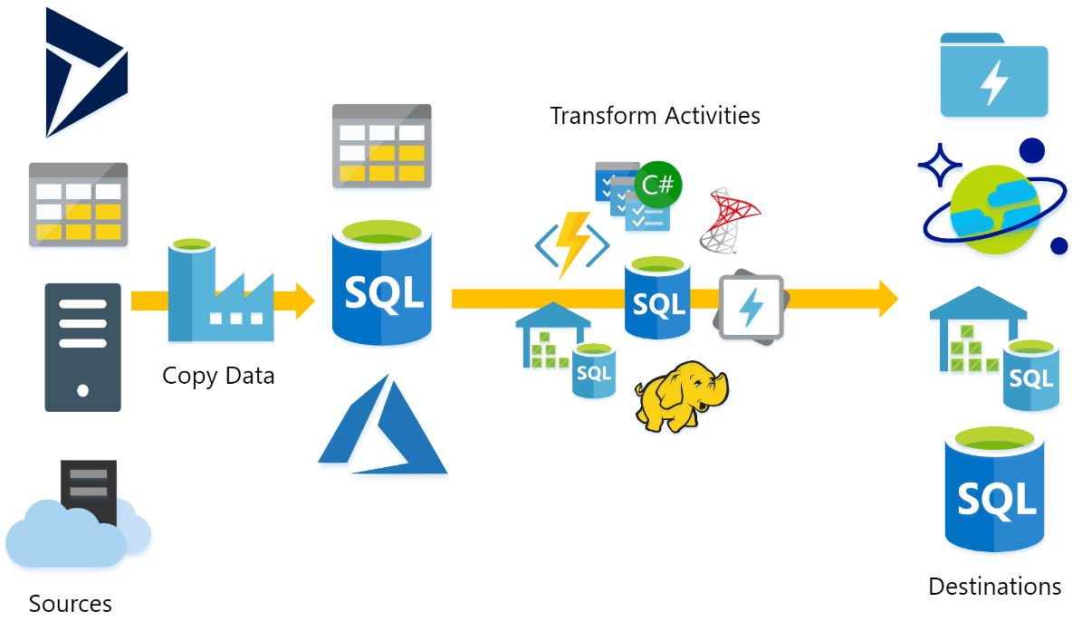
What does ADF do?
Source : P.Andrew

Slide 44

Azure Data Factory Concept
Dataset
(eg. tables, files)
Activity
(eg. Copy, Hive job,
SP, ADLA job)
Pipeline
(schedule,monitor,
manage)
Consumes
Is a
logical
grouping of
Produces
Represents
data item(s)
stored in
Runs on
Linked Services
(eg. SQL Server,
HDInsight,ADLA)
Triggers
Notes:
Activities
Actions you perform on your data
Inputs turned into outputs
Pipelines
Logical grouping of activities for group operations
Data sets
A named reference/pointer to data you want to use as an input or output of an activity
Linked services
Connection of data factories to the resources and services you want to use
Connection of data stores like Azure storage and on-premises SQL Server
Connection of compute services like Azure Machine Learning, Azure HDInsight, and Azure Batch

Slide 45
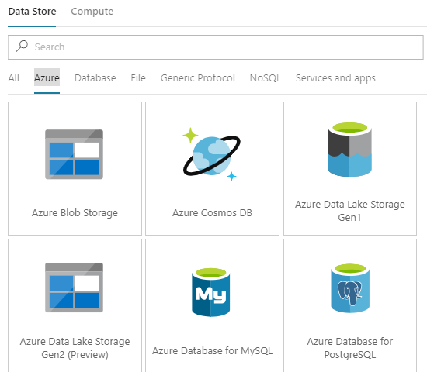
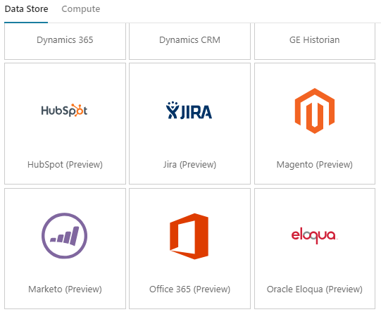
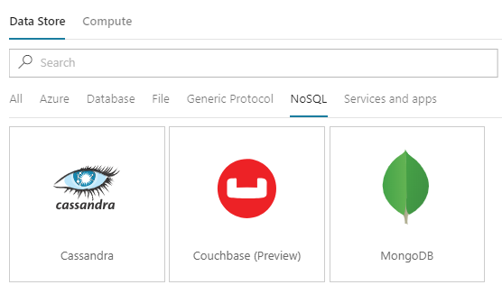
Azure Data Factory – Linked Services
More than 70 connectors

Slide 46
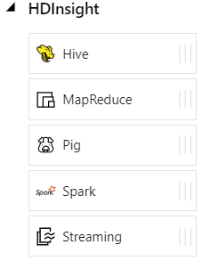
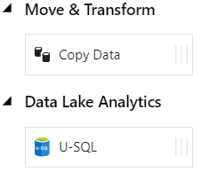
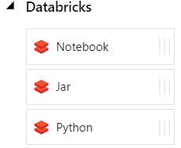
Azure Data Factory - Data activities
Data movement activities : Copy Activity
Data transformation activities :
HDInsight (Hive, Pig, MapReduce ,Hadoop Streaming ,Spark)
Azure Databricks Notebooks, Jars, Pythons
Machine Learning activities: Batch Execution and Update Resource (*)
Stored Procedure
Data Lake Analytics U-SQL
DotNet (Custom)

Slide 47
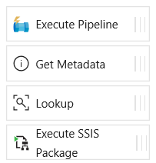
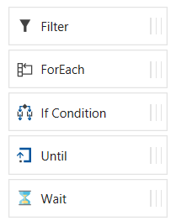
Azure Data Factory - Control flow activities
Execute Pipeline Activity
ForEach Activity
Web Activity
Lookup Activity
Get Metadata Activity
Until Activity
If Condition Activity
Wait Activity

Slide 48
Azure Data Factory – What else ?
Parameters
Expressions
Dynamic Content
Functions
Branching
On success
On failure
On completion
Activity 2
On success
Activity 1
(eg. Copy, Hive job,
SP, ADLA job)
Activity 3
On completion
On failure
Activity 4

Slide 49
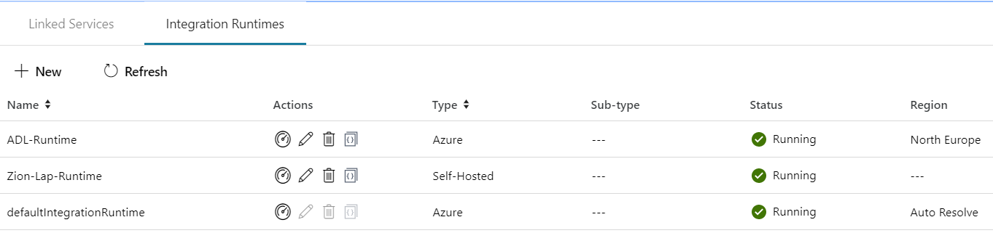
Integration runtime(s) in Azure Data Factory
The Integration Runtime (IR) is the compute infrastructure used by Azure Data Factory to provide the following data integration capabilities across different network environments
Integration runtime types:
Azure (Data movement and activity on Azure)
Self-hosted (Data movement and activity dispatch between public and private network)
Azure-SSIS (SSIS package execution)

Slide 50

Self Hosted Integration runtime
Now called Self Hosted Integration Runtime
Before Data Management Gateway
One version for ADF V1 and V2
SSL Port : 443
One to Many

Slide 51
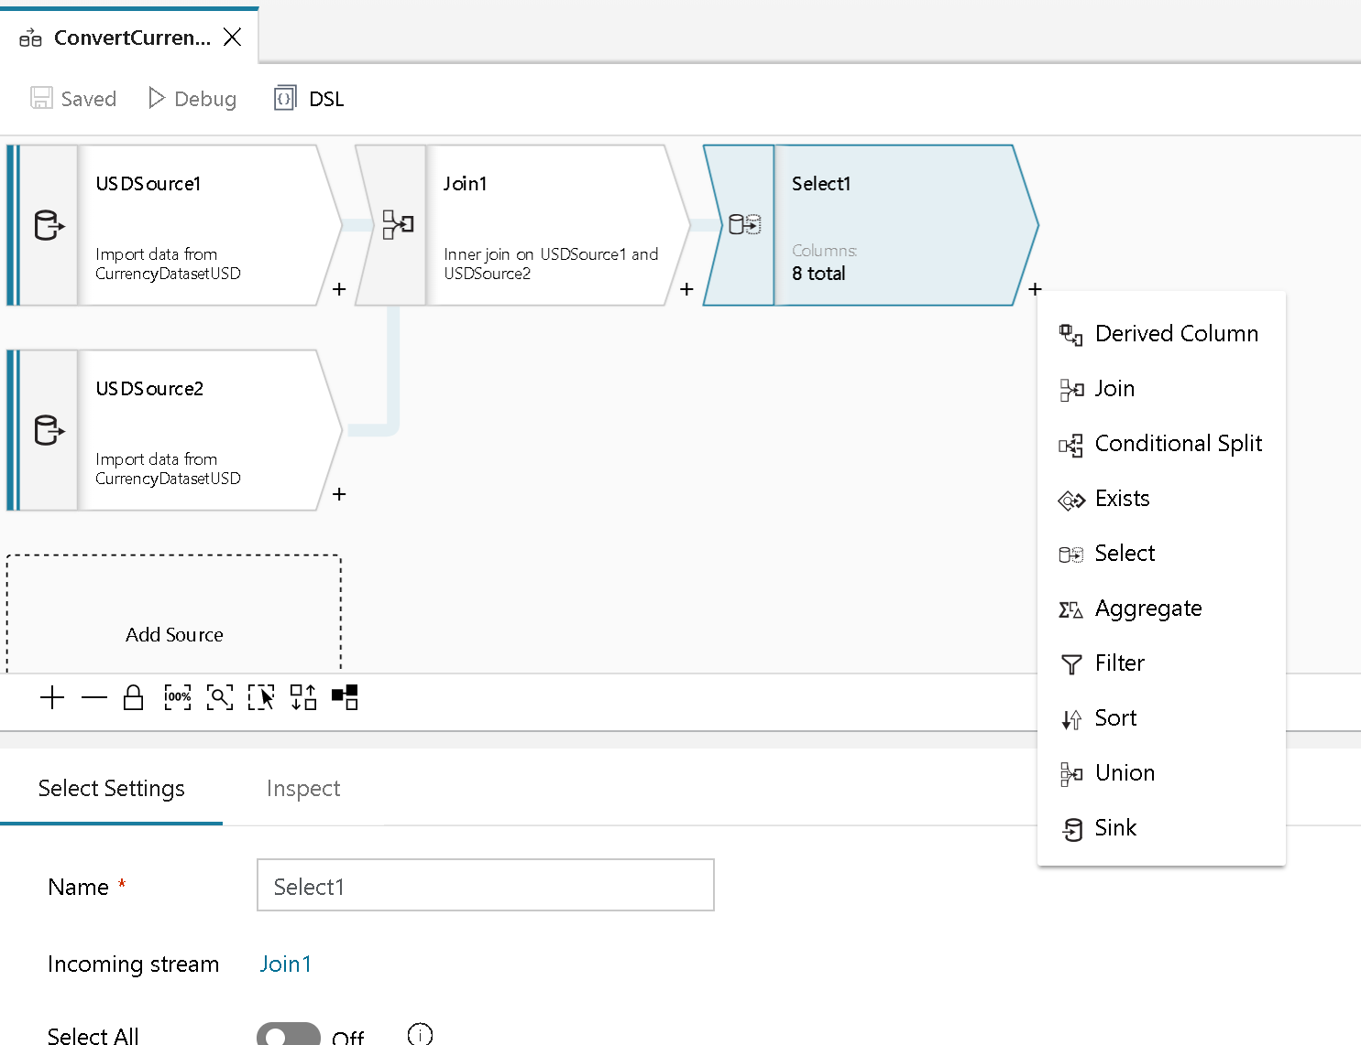
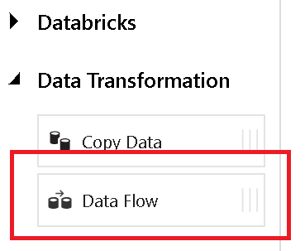
Azure Data Factory- DataFlow (Preview)
+
Azure Data Factory
Azure Databricks

Slide 52
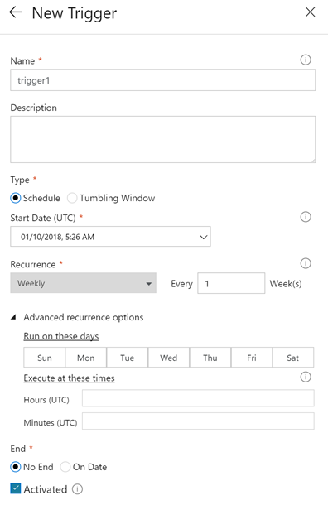
Pipeline execution and triggers in Azure Data Factory
Manual execution (on-demand)
The REST API
The .NET SDK
Trigger execution
Schedule trigger
Tumbling window trigger

